Slide 1
Global AI Jobs Presentation

Slide 2
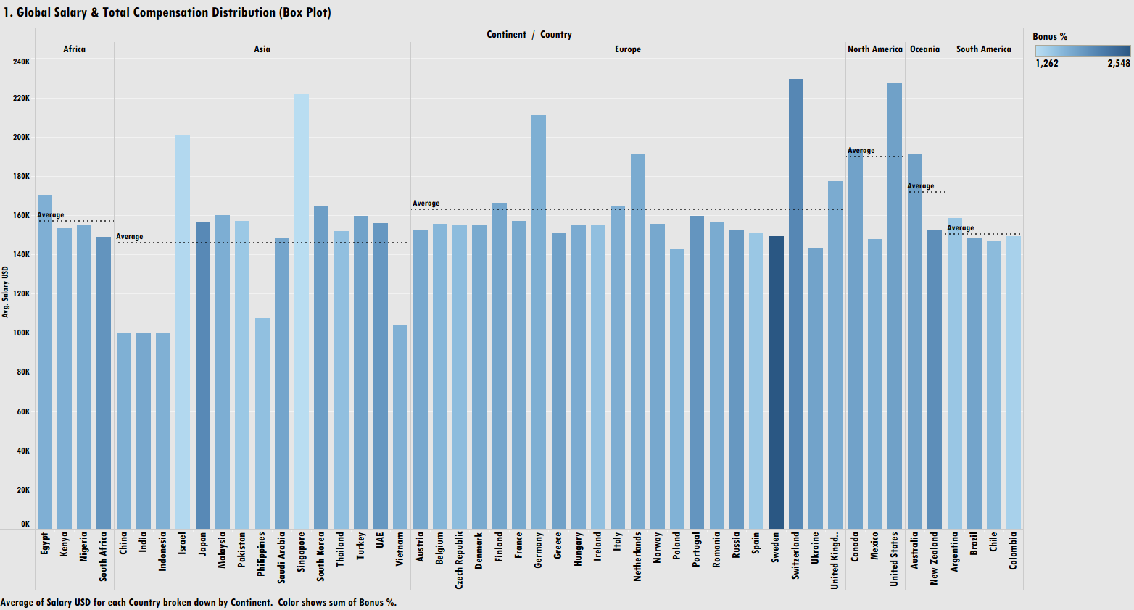

Slide 3
Regional Salary Benchmarks: North America leads all continents with the highest average base salary benchmark (~$180K USD), followed by Europe (~$160K USD) and Africa (~$160K USD). Asia, Oceania, and South America maintain lower average baselines between $140K and $150K USD.
Top Country Outliers: Switzerland commands the highest average base salary globally (~$230K USD), followed closely by the United States (~$222K USD) and Singapore (~$220K USD).
Intra-Regional Disparities:
  Asia: Shows high internal variance, ranging from ~$100K USD in China, India, and Indonesia to over $200K USD in Israel and $220K USD in Singapore.
  North America: Displays a significant gap between high-paying hubs in the US (~$222K USD) / Canada (~$190K USD) versus lower baselines in Mexico (~$145K USD).
Bonus Compensation Mix (Color Scale):
  High Variable Bonus Markets (Light Blue): Markets like Singapore, Israel, United States, Germany, and Switzerland lean heavily on variable incentive bonuses (scaling up to 2,548%).
  High Fixed Base Markets (Dark Blue): Markets like Japan and Sweden display darker shades, indicating higher base salaries with a lower percentage allocated to variable bonuses.
Visualization Format Note: While titled as a "Box Plot," the view actually renders as a Grouped Bar Chart showing Average Salary USD by country and continent, with bar color representing Sum of Bonus %.

Slide 4
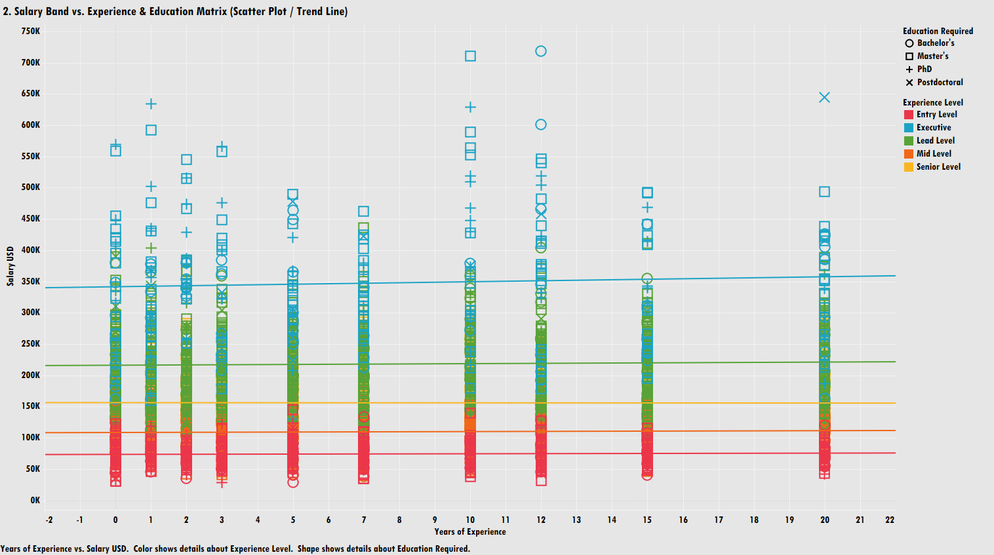

Slide 5
Clear Tiering by Experience Level:
  Entry Level (Red): Concentrates heavily under $100K–$150K USD across all experience years.
  Mid Level (Orange) & Lead Level (Green): Occupy intermediate compensation bands, ranging between $150K and $250K USD.
  Executive (Blue): Dominates the top salary tier, spanning from $350K to over $700K USD.
Flat Progression Within Experience Levels:
  Trend lines for each experience level are nearly horizontal, demonstrating that accumulating years of tenure within a single tier does not meaningfully increase base pay.
  Vertical progression (advancing from Entry $\rightarrow$ Lead $\rightarrow$ Executive) yields significantly higher pay increases than horizontal tenure growth.
Education Drives High Compensation Outliers:
  Top pay outliers ($500K–$700K+ USD) consist primarily of Master's ($\square$), PhD ($+$), and Bachelor's ($\bigcirc$) degree requirements.
  Postdoctoral ($\times$) roles appear at both lower entry-level compensation bands ($0–3$ years) and upper executive levels ($20$ years).
Significant Compensation Dispersion: At identical experience benchmarks (e.g., 0, 10, or 12 years), base salaries vary widely from under $50K to over $700K USD based on job title tier and education requirements.

Slide 6
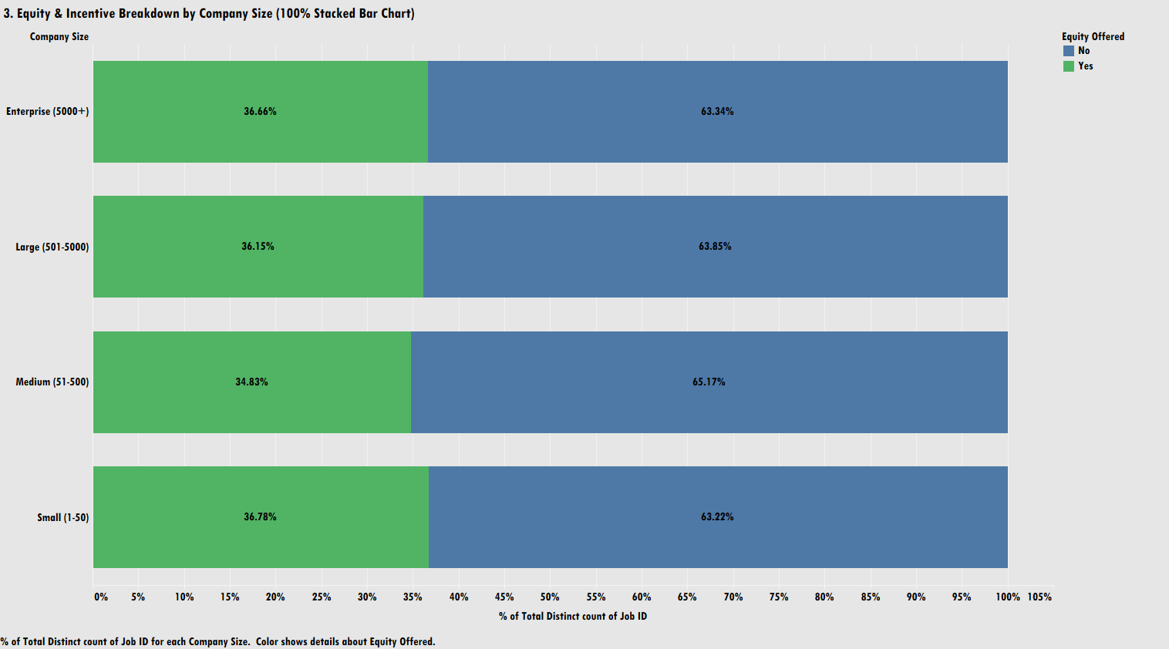

Slide 7
Consistent Equity Standard Across Tiers: Across all organization tiers, roughly one-third (~35%–37%) of job postings include equity, while two-thirds (~63%–65%) do not.
Highest Equity Rates in Small Companies: Small companies (1–50 employees) offer equity at the highest rate among all size tiers at 36.78%.
Enterprise Offerings Follow Closely: Enterprise organizations (5000+ employees) rank second, offering equity in 36.66% of posted roles.
Lowest Adoption in Medium Firms: Medium-sized companies (51–500 employees) report the lowest equity inclusion rate at 34.83% (with 65.17% offering no equity).
Low Overall Variance Across Scale: The total variation between the highest tier (Small at 36.78%) and lowest tier (Medium at 34.83%) is less than 2 percentage points, indicating company scale does not significantly alter equity offering likelihood.

Slide 8
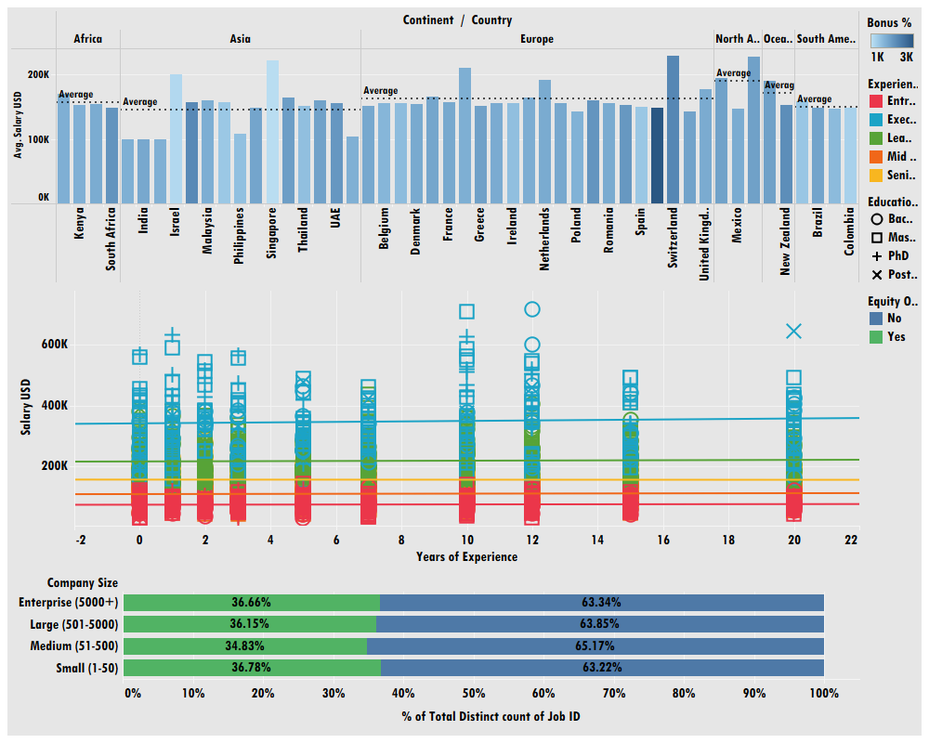

Slide 9
Cross-Dimensional Compensation Architecture: Global AI compensation relies on a multi-tiered rewards model where geographic market determines the base pay ceiling (e.g., ~$230K in Switzerland/US vs. ~$100K in emerging Asian markets), role level dictates fixed salary progression rather than linear tenure, and equity inclusion remains universally baseline-standardized across roughly 35%–37% of all roles regardless of company scale.
Hierarchy and Skill over Tenure: Career progression data shows that accumulating years of experience within a single level yields minimal salary increases (reflected in flat tenure trend lines). Significant compensation jumps require vertical title elevation (e.g., advancing to Lead or Executive) or specialized educational credentials (Master’s/PhD).
Universal Total Rewards Standardization: Despite stark geographic salary gaps and clear experience-tier boundaries, equity offering rates remain remarkably consistent across company sizes—ranging tightly between 34.83% (Medium) and 36.78% (Small). This highlights that equity is treated as a standard talent acquisition incentive rather than a benefit exclusive to large enterprises or early-stage startups.
Strategic Talent Acquisition Opportunities: Multi-national organizations can optimize HR budgets by leveraging geographic salary arbitrage across neighboring countries, while structuring competitive offers around bonus incentives and clear vertical career pathways rather than relying solely on tenure-based compensation.

Slide 10
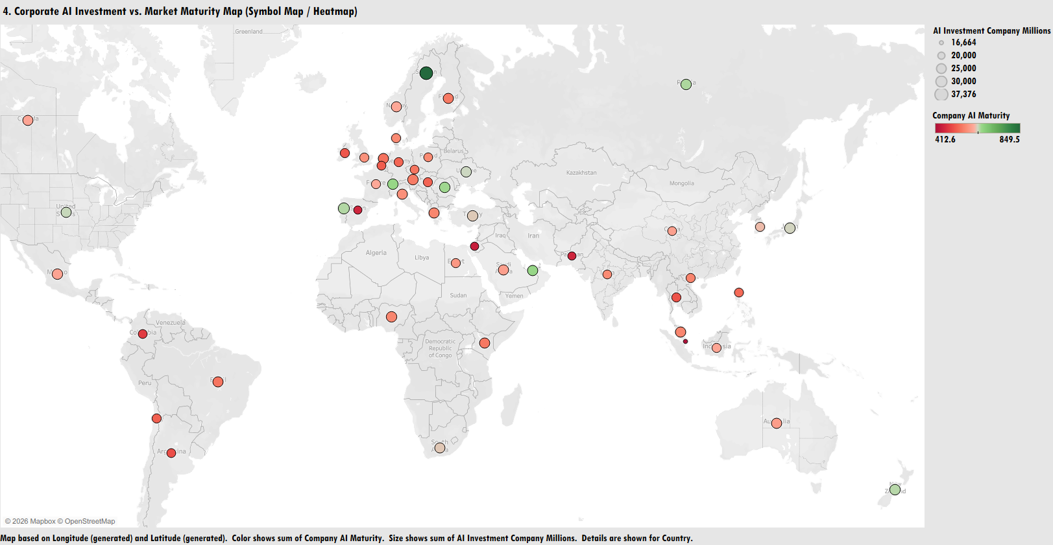

Slide 11
Global Investment Concentration: Corporate AI investment capital is heavily clustered in Europe and Asia, with secondary hubs distributed across North America, South America, and Africa.
Capital Scale Dispersion (Bubble Size): Corporate AI investment per country ranges from $16,664 Million up to $37,376 Million, as indicated by the symbol sizing.
AI Market Maturity Variance (Color Gradient):
  High Maturity Markets (Green): Higher sum of company AI maturity scores (scaling up to 849.5) are heavily concentrated in Northern & Western Europe (notably Scandinavia).
  Emerging/Lower Maturity Markets (Red/Orange): Markets with lower maturity scores (starting at 412.6) dominate regions across Southern Europe, parts of Asia, Africa, and South America.
Investment vs. Maturity Decoupling: Large investment volumes (larger bubbles) do not always align with high AI maturity (green dots). Several emerging markets feature sizable investment bubbles despite displaying lower overall maturity scores (red/orange dots).

Slide 12
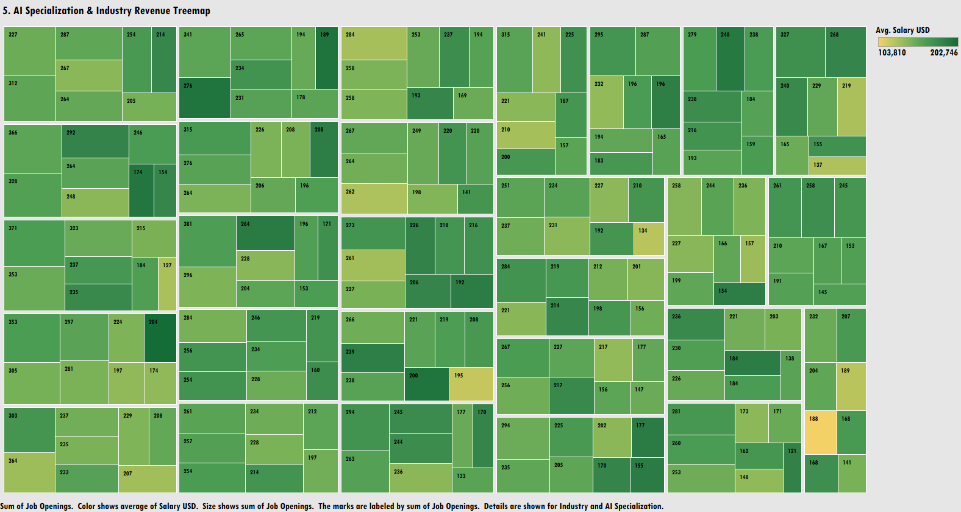

Slide 13
Job Volume Distribution (Tile Size): Demand for AI talent is highly fragmented, with individual specialization/industry segments scaling up to 381 job openings per block.
Wide Base Salary Range (Color Gradient):
  Average compensation across industry and specialization pairs ranges from $103,810 USD (light yellow/olive) to $202,746 USD (dark forest green).
  Higher salaries (darker green tiles) are spread across both high-volume segments and niche roles.
High-Volume, High-Pay Hotspots: Top-tier segments combine high job demand (300+ openings) with premium compensation bands (dark green hues), reaching peak volumes like 381, 371, and 366 openings.
Low-Volume, Premium Niche Segments: Several smaller tiles display dark green shading, showing that specific specialized skill sets command top-tier compensation (~$200K USD) despite lower total hiring demand.
Entry/Lower Pay Segments: Lighter yellow-green blocks highlight segments where average pay drops closer to the $103K–$130K USD baseline (e.g., blocks labeled 127, 133, 134, 137).

Slide 14
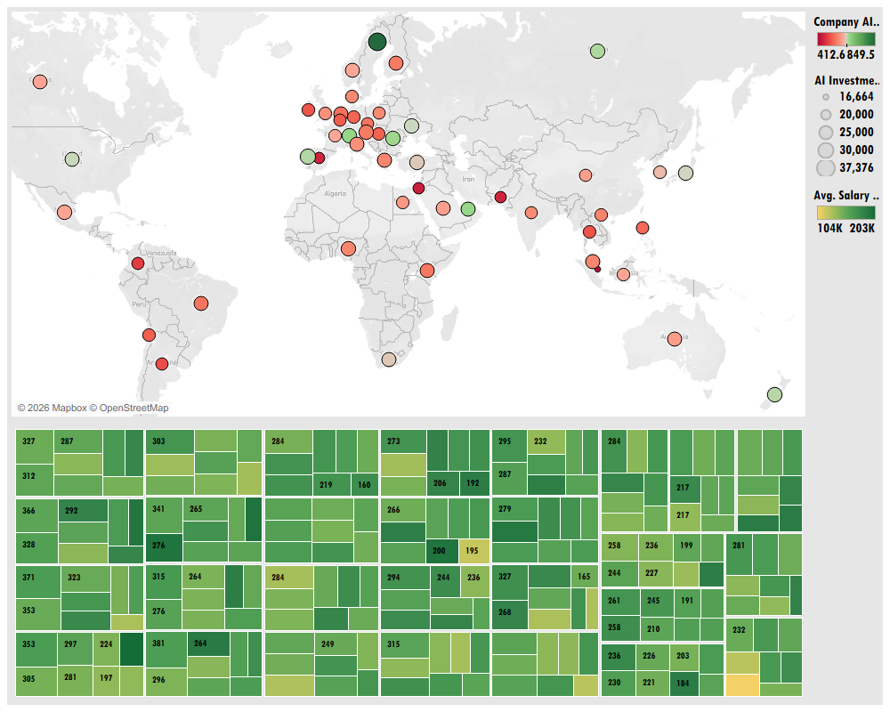

Slide 15
Strategic Capital vs. Skill Sourcing Alignment: Global AI growth is driven by a dual-axis strategy—capital deployment is concentrated in key geographical growth markets across Europe and Asia, while operational recruitment requires balancing high-volume mainstream roles against premium-priced niche specializations.
Investment Dispersion vs. Market Maturity: Corporate investment volumes (ranging up to $37.37B per country) do not automatically equal market maturity. Highly mature ecosystems (e.g., Scandinavia reaching maturity scores of 849.5) serve as primary hubs for specialized talent, whereas high-investment, lower-maturity regions (scoring near 412.6) indicate active expansion markets requiring rapid talent acquisition.
Specialization-Driven Compensation Structure: Within active hiring pipelines, talent demand spans up to 381 openings per segment. However, salary ranges (spanning $103,810 to $202,746 USD) are driven by skill specialization rather than sheer posting volume. Both high-volume core roles and low-volume niche skill sets command top-tier ~$200K compensation.
Optimized Global Expansion Framework: Organizations expanding globally must pair geographical market selection (capital vs. maturity) with tailored talent acquisition strategies—allocating premium budgets to scarce technical skill sets while scaling entry and mid-tier roles cost-effectively in developing markets.

Slide 16
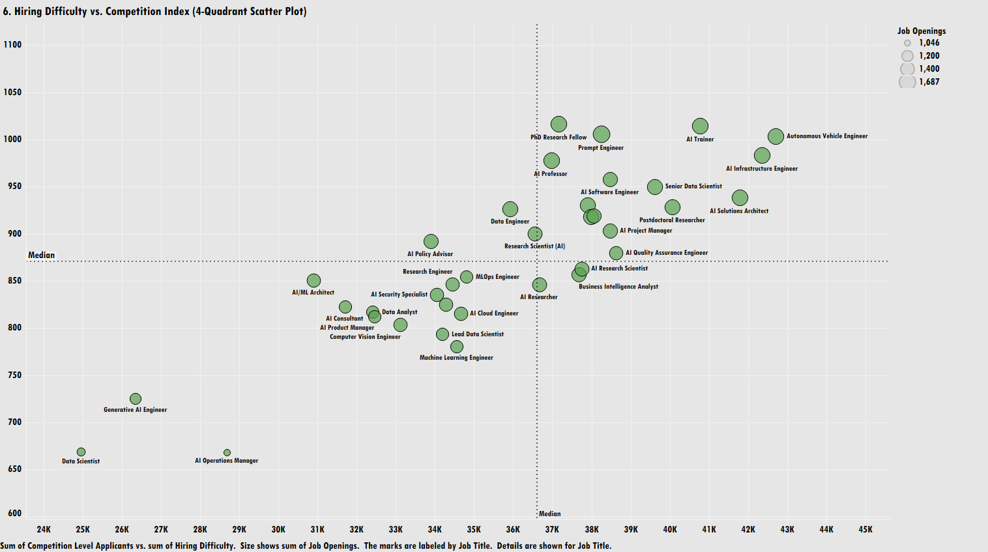

Slide 17
Clear 4-Quadrant Market Segmentation: The chart divides AI roles along two axes—Competition Level / Applicants (horizontal, median at ~36.8K) and Hiring Difficulty (vertical, median at ~880).
High Competition & High Hiring Difficulty (Top-Right Quadrant): Roles like Autonomous Vehicle Engineer, AI Trainer, Prompt Engineer, PhD Research Fellow, and AI Infrastructure Engineer exhibit both high applicant competition (>37K) and extreme hiring difficulty index scores (950–1000+).
Low Competition & High Hiring Difficulty (Top-Left Quadrant): Data Engineer sits near this quadrant boundary with relatively lower applicant counts (~36K) but high hiring difficulty (~930).
Low Competition & Low Hiring Difficulty (Bottom-Left Quadrant): Roles including Data Scientist, Generative AI Engineer, and AI Operations Manager reflect lower competition (24K–29K applicants) and significantly lower hiring difficulty (650–720).
Moderate/High Competition & Lower Difficulty (Bottom-Right Quadrant): Business Intelligence Analyst, AI Research Scientist, and Machine Learning Engineer show moderate-to-high competition (33K–38K applicants) with hiring difficulty index scores below the median (<880).
Job Openings Demand (Bubble Sizing): Total job openings across roles range from 1,046 to 1,687, showing steady hiring volume across both niche high-difficulty roles and lower-difficulty positions.

Slide 18
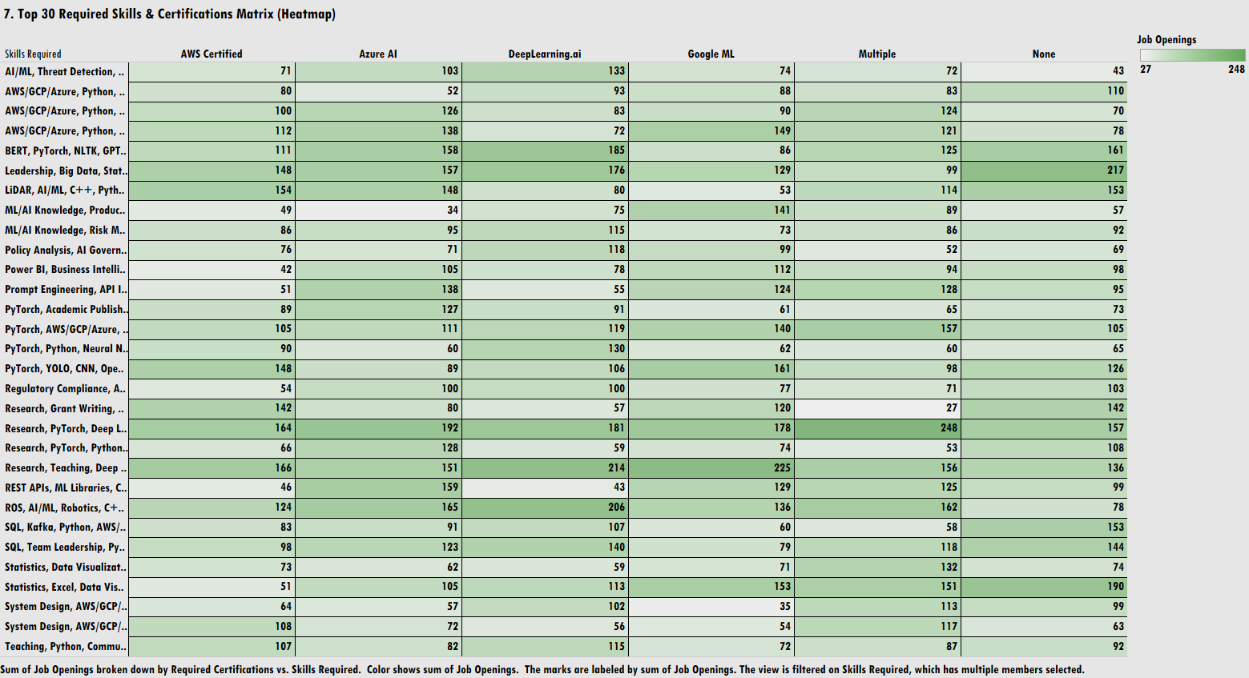

Slide 19
Highest Demand Skill-Certification Hubs (Darkest Green):
  Research, PyTorch, Deep L... + Multiple Certifications: Represents the single highest demand concentration in the matrix with 248 job openings.
  Research, Teaching, Deep ... + Google ML / DeepLearning.ai: Generates intense demand clusters, reaching 225 job openings (Google ML) and 214 job openings (DeepLearning.ai).
  ROS, AI/ML, Robotics, C++... + DeepLearning.ai: Drives high specialized demand with 206 job openings.
Impact of "No Certification" Requirement: High-volume hiring exists even without explicit certifications. Key examples include Leadership, Big Data, Stat... (217 openings), Statistics, Excel, Data Vis... (190 openings), and BERT, PyTorch, NLTK, GPT... (161 openings).
Core Technological Skills Distribution: Skill sets combining PyTorch, YOLO, CNN and PyTorch, AWS/GCP/Azure show strong, consistent demand across almost all certification channels, averaging 100–161 openings per block.
Opening Volume Range (Matrix Scale): Individual cell volumes span from 27 job openings up to 248 job openings, highlighting localized skill/certification preferences.

Slide 20
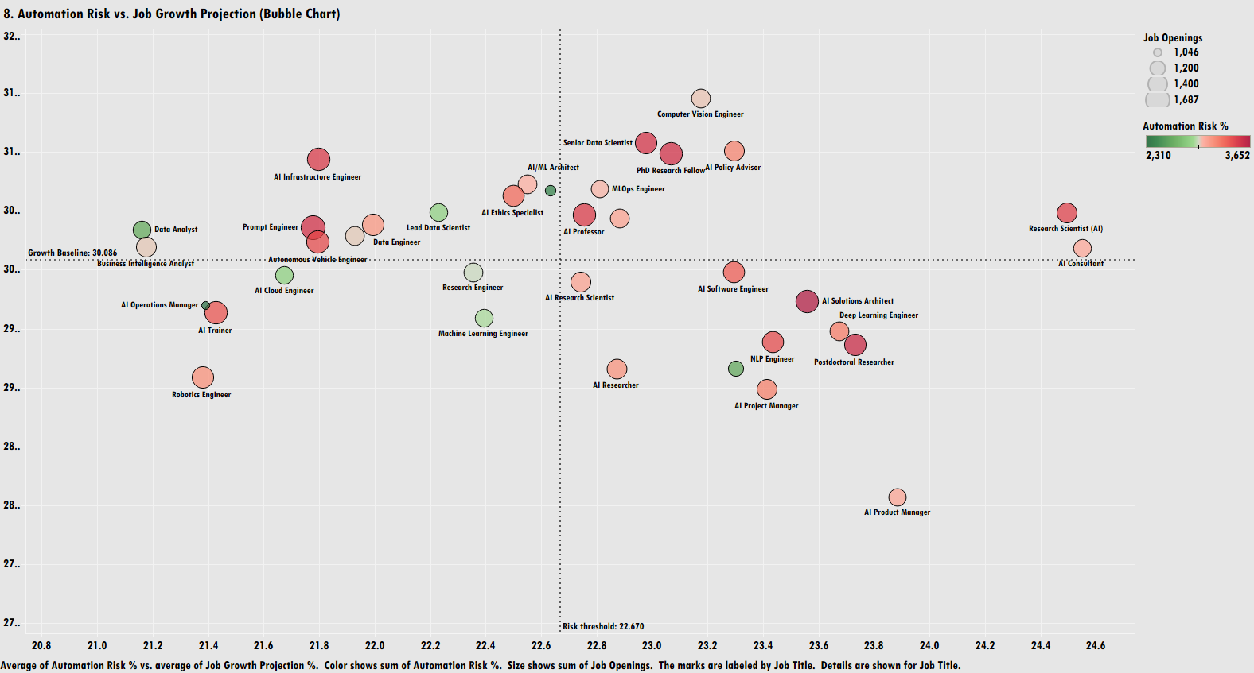

Slide 21
Clear Risk vs. Growth Quadrant Separation: The chart maps AI roles against a Risk Threshold (vertical reference line at 22.67% Automation Risk) and a Growth Baseline (horizontal reference line at 30.086% Job Growth Projection).
High Growth & Higher Automation Risk (Top-Right Quadrant):
  Roles like Computer Vision Engineer, Senior Data Scientist, PhD Research Fellow, AI Policy Advisor, and MLOps Engineer achieve above-average growth (>30%) but face higher automation risk (>22.67%).
  Research Scientist (AI) sits furthest right, registering the highest automation risk score (near 24.5%).
High Growth & Lower Automation Risk (Top-Left Quadrant - Future-Proof Stars): Roles including AI Infrastructure Engineer, Data Analyst, Prompt Engineer, Lead Data Scientist, and Autonomous Vehicle Engineer achieve above-baseline growth while staying safely below the 22.67% risk threshold.
Lower Growth & High Automation Risk (Bottom-Right Quadrant):
  Positions such as AI Product Manager, NLP Engineer, Deep Learning Engineer, AI Solutions Architect, and Postdoctoral Researcher display below-average growth projections alongside elevated automation risk.
  AI Product Manager records the lowest overall projected growth (~27.5%).
Lower Growth & Lower Automation Risk (Bottom-Left Quadrant): Roles like Robotics Engineer, AI Operations Manager, AI Trainer, AI Cloud Engineer, and Machine Learning Engineer sit below both the growth baseline and risk threshold.
Metrics & Sizing: Bubble size indicates Job Openings (scaling from 1,046 to 1,687), while the color scale reflects total Automation Risk % (ranging from green at 2,310 to red at 3,652).

Slide 22
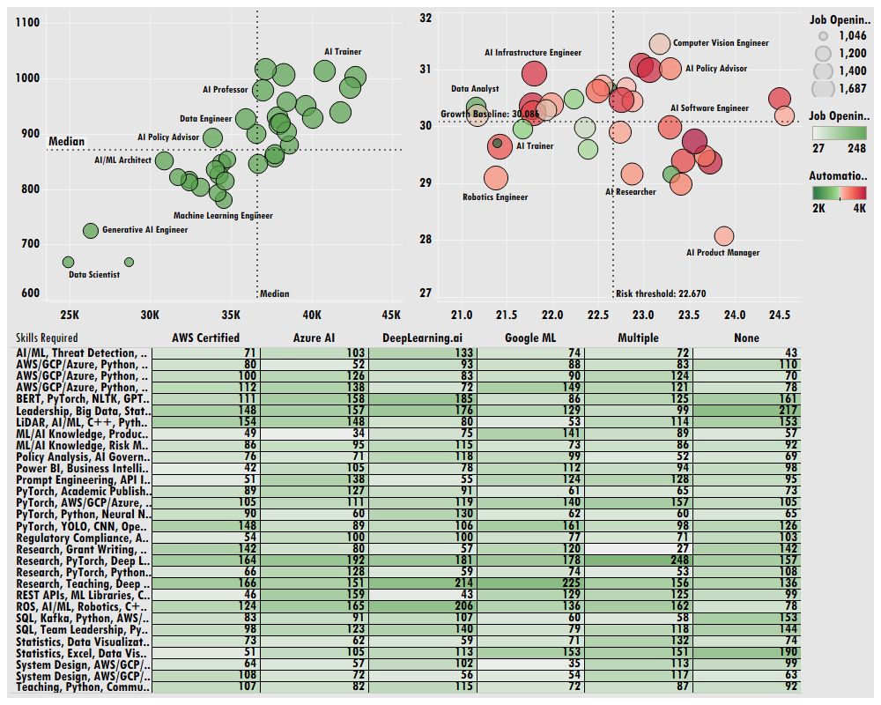

Slide 23
Hiring Bottlenecks & The Qualification Paradox: High applicant volume does not guarantee hiring ease. Roles like Autonomous Vehicle Engineer and AI Infrastructure Engineer face extreme competition (>37K applicants) alongside maximum hiring difficulty scores (>950). Conversely, low-friction roles like Generative AI Engineer offer faster talent acquisition pathways.
Vendor-Certification Demand Drivers: Sourcing pipelines are heavily optimized around specific credential-skill pairings. Combining PyTorch/Deep Learning skills with vendor certifications (Google ML, DeepLearning.ai) unleashes peak market demand (scaling up to 248 openings per segment). However, core leadership and basic analytics remain high-volume hiring drivers even without mandatory certifications.
Future-Proofing the AI Workforce: Long-term headcount strategy must align with automation trends. Top-Left "Future-Proof" roles (e.g., AI Infrastructure Engineer, Data Analyst) combine above-average growth (>30%) with low automation risk (<22.67%). Meanwhile, routine technical roles facing elevated automation risk (e.g., Research Scientists at ~24.5% risk) require continuous upskilling toward infrastructure and systems engineering.
Integrated Talent Strategy: Organizations must deploy targeted screening for high-volume bottleneck roles, sponsor specialized vendor-ML certifications for core engineering teams, and actively shift workforce planning toward automation-resilient infrastructure positions.

Slide 24
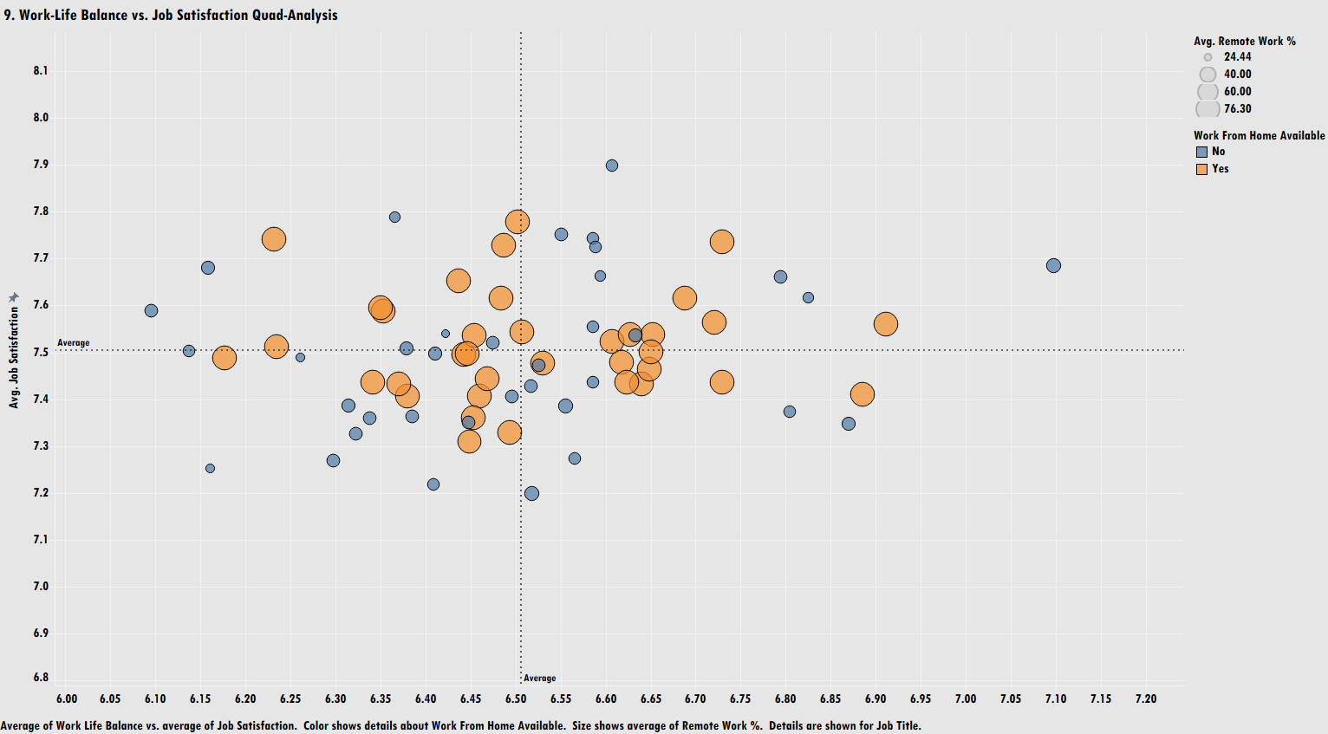

Slide 25
Clear 4-Quadrant Satisfaction Breakdown: The plot splits AI roles across an Average Work-Life Balance score (horizontal axis, median/average baseline at 6.51) and an Average Job Satisfaction score (vertical axis, average baseline at 7.50).
Work-From-Home (WFH) Impact on Remote Work % (Color vs. Size):
  WFH Available = "Yes" (Orange): Roles offering WFH flexibility display consistently larger bubble sizes, correlating with higher Average Remote Work % (scaling up to 76.30%).
  WFH Available = "No" (Blue): Non-WFH roles feature noticeably smaller mark sizes, corresponding to low remote work percentages (~24.44%).
High WLB & High Job Satisfaction (Top-Right Sweet Spot):
  Roles in this optimal quadrant score above average on both metrics (>6.51 WLB and >7.50 Job Satisfaction).
  Orange marks predominate in this high-performing zone, highlighting that remote/WFH availability heavily supports top-tier employee sentiment.
High Satisfaction Despite Lower WLB (Top-Left Quadrant):
  Several roles register high job satisfaction (7.6–7.9) despite lower work-life balance scores (<6.50).
  A mix of both WFH (Orange) and non-WFH (Blue) roles appear here, showing high job engagement can sometimes offset long hours.
Low WLB & Low Satisfaction Risk Zone (Bottom-Left Quadrant): Roles clustering below both baselines (<6.51 WLB, <7.50 Satisfaction) reflect burnout and retention risks. Non-WFH (Blue) roles make up a noticeable share of this lower quadrant.

Slide 26
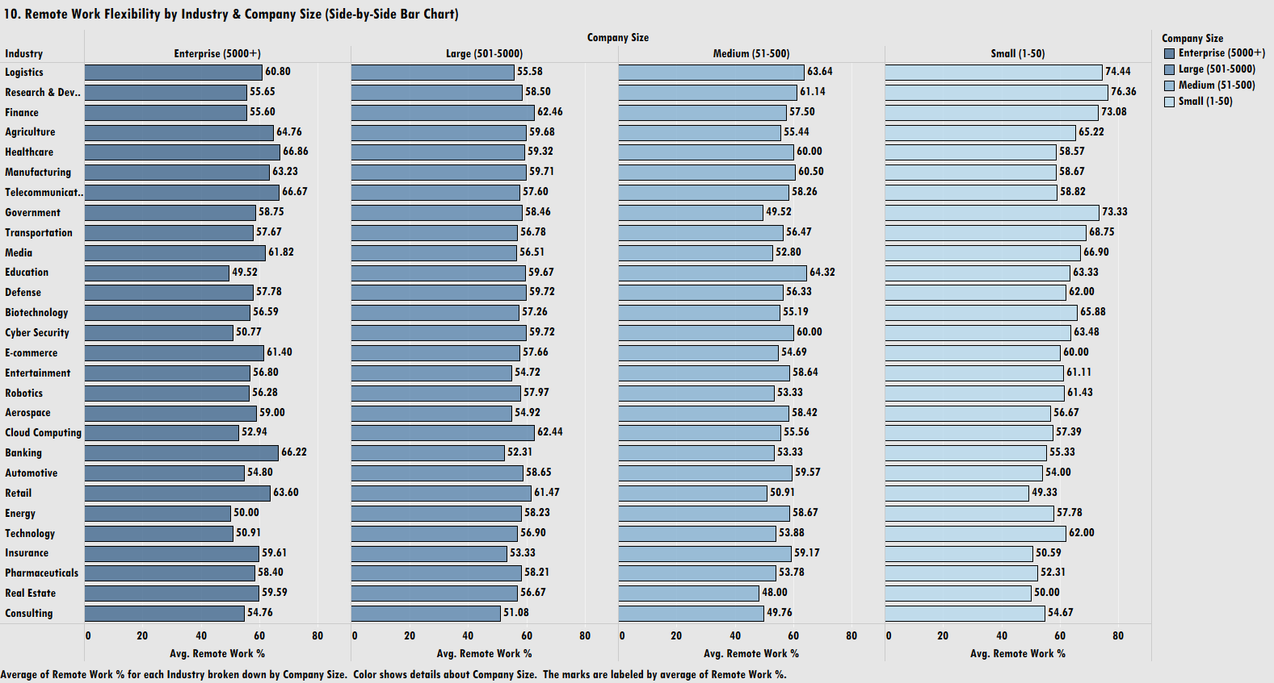

Slide 27
Higher Remote Flexibility in Small Companies: Small firms (1–50 employees) achieve peak remote work averages across multiple sectors, reaching top values in Research & Development (76.36%), Logistics (74.44%), Government (73.33%), and Finance (73.08%).
Enterprise-Level Remote Flexibility Variations: Enterprise firms (5000+ employees) show strong remote adoption in Healthcare (66.86%), Telecommunications (66.67%), and Banking (66.22%), but dip lower in Education (49.52%), Energy (50.00%), and Technology (50.91%).
Consistent Baseline Across Middle Market Tiers: Large (501–5000) and Medium (51–500) companies maintain relatively stable remote work averages, mostly clustering between 50% and 65% across all industries.
Industry-Specific Agility Gaps:
  Logistics & Research & Development: Display the largest agility gap, jumping from ~55%–60% remote work in Enterprise/Large environments to ~74%–76% in Small startups.
  Retail: Shows an inverted trend, where Enterprise firms average 63.60% remote work while Small firms lag at 49.33%.
Narrow Overall Range Across Scale: Average remote work percentages across all industry/size combinations range from a low of 48.00% (Real Estate, Medium) to a high of 76.36% (Research & Development, Small).

Slide 28
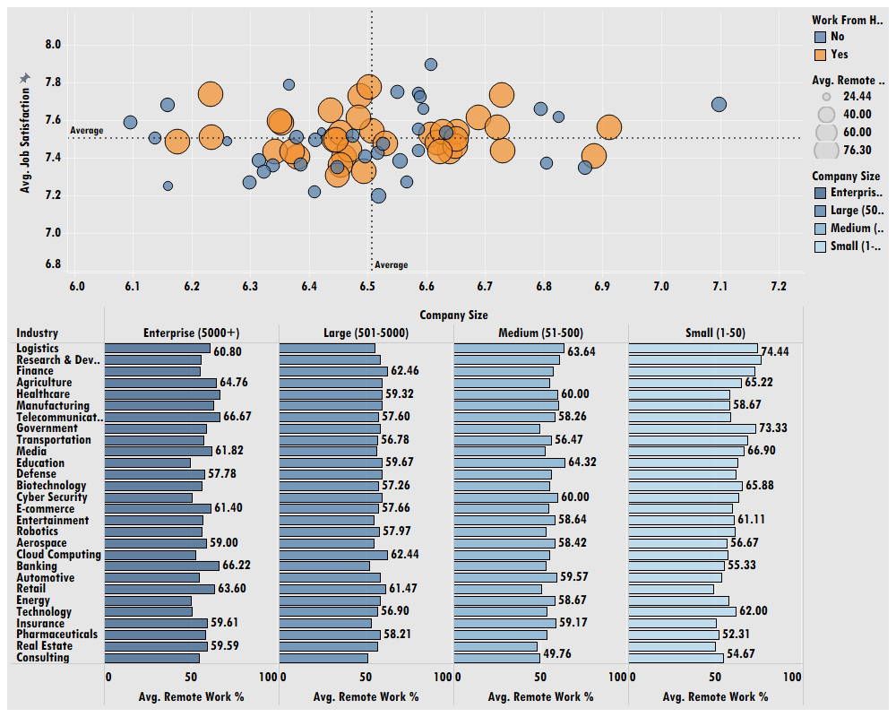

Slide 29
Remote Policy as a Primary Engagement Driver: Employee satisfaction in AI roles is directly anchored to workplace flexibility. Roles offering Work-From-Home (WFH) options achieve higher average remote work rates (up to 76.30%) and cluster heavily in top-tier job satisfaction zones (>7.50 rating).
Scale-Driven Remote Work Agility: Remote work adoption varies significantly across company size tiers, ranging from 48.00% (Medium Real Estate) to 76.36% (Small R&D). Small firms (1–50 employees) lead the market in offering flexible remote models across high-demand sectors like R&D (76.36%), Logistics (74.44%), and Finance (73.08%).
Enterprise Targeted Hybrid Strengths: While small companies leverage remote flexibility for recruitment agility, Enterprise organizations (5000+ employees) maintain robust remote structures in security-sensitive or regulated sectors, including Healthcare (66.86%), Telecommunications (66.67%), and Banking (66.22%).
Strategic Retention Takeaway: To prevent burnout and reduce attrition risks—particularly in roles falling into lower satisfaction quadrants—organizations must align remote work policies with industry benchmarks, using flexible work arrangements as a key tool for employee retention.

Slide 30
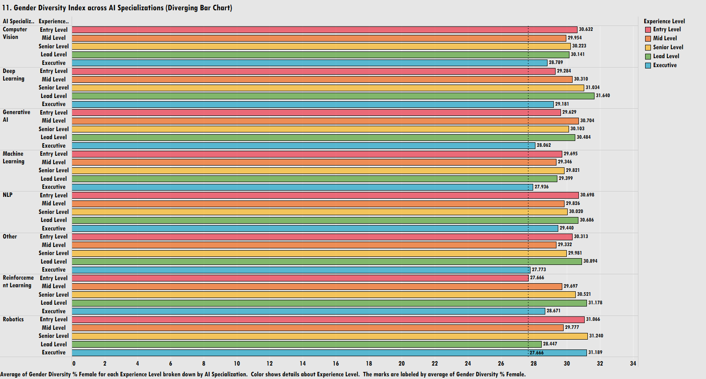

Slide 31
Tight Female Representation Band (27%–32%): Average female representation across all AI specializations and experience levels remains narrow, ranging between 27.666% and 31.640%.
Consistent Executive Level Drop-Off (The "Leaky Pipeline"):
  Across almost every specialization, the Executive level (Blue bar) records the lowest or near-lowest female representation.
  Lowest executive percentages occur in Other (27.773%), Machine Learning (27.936%), and Generative AI (28.062%).
Outlier at Executive Tier in Robotics: Robotics stands out as the sole exception where the Executive level (31.189%) holds the highest female representation within its specialization group.
Peak Representation in Lead & Senior Tiers:
  Deep Learning (Lead Level): Commands the highest female representation across the entire matrix at 31.640%.
  Reinforcement Learning (Lead Level): Follows closely at 31.178%.
  Robotics (Senior Level): Achieves 31.240%.
Specialization Highlights:
  Computer Vision: Shows flat representation across tiers, peaking at Entry Level (30.632%) and dipping at Executive Level (28.789%).
  NLP: Peaks at Lead Level (30.686%) and Entry Level (30.698%).

Slide 32
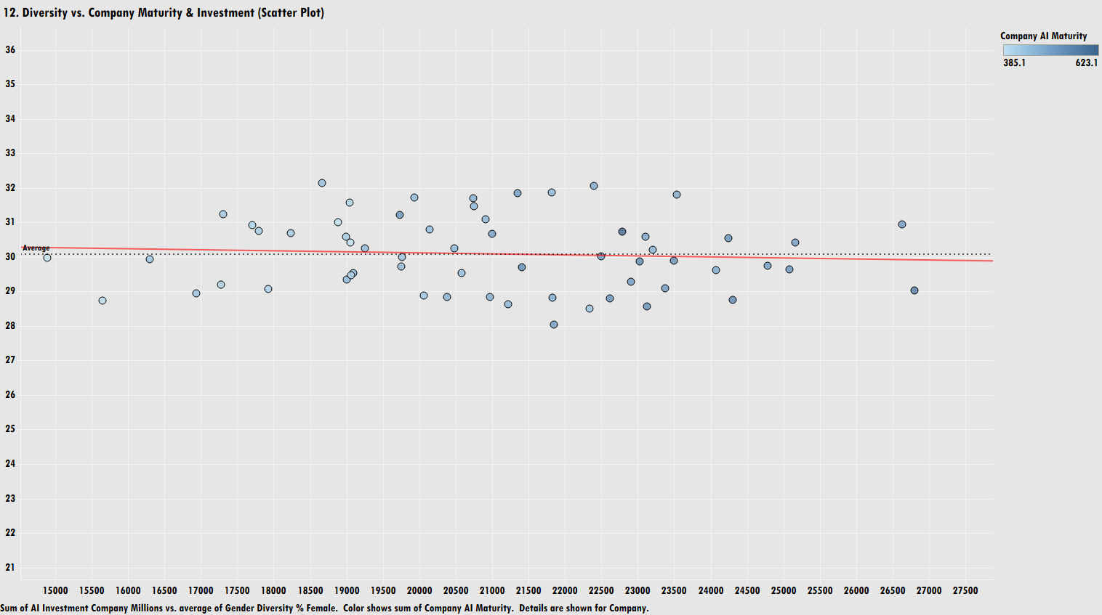

Slide 33
Flat Linear Trend Line: The trend line across investment volume is virtually horizontal, demonstrating that higher corporate AI investment does not drive higher gender diversity.
Consistent Baseline Diversity Score: Average female representation across companies clusters tightly around the 30% mark (ranging roughly between 28% and 32%) regardless of investment scale.
Wide Range of Investment Capital: Company AI investment spans from $15,000 Million to over $27,000 Million, yet gender diversity metrics remain static across both low and high spenders.
Maturity Score Impact (Color Gradient): Company AI maturity scores range from 385.1 to 623.1. High maturity companies (darker blue circles) are distributed evenly across all diversity levels, confirming that AI operational maturity also fails to move the needle on gender parity.

Slide 34
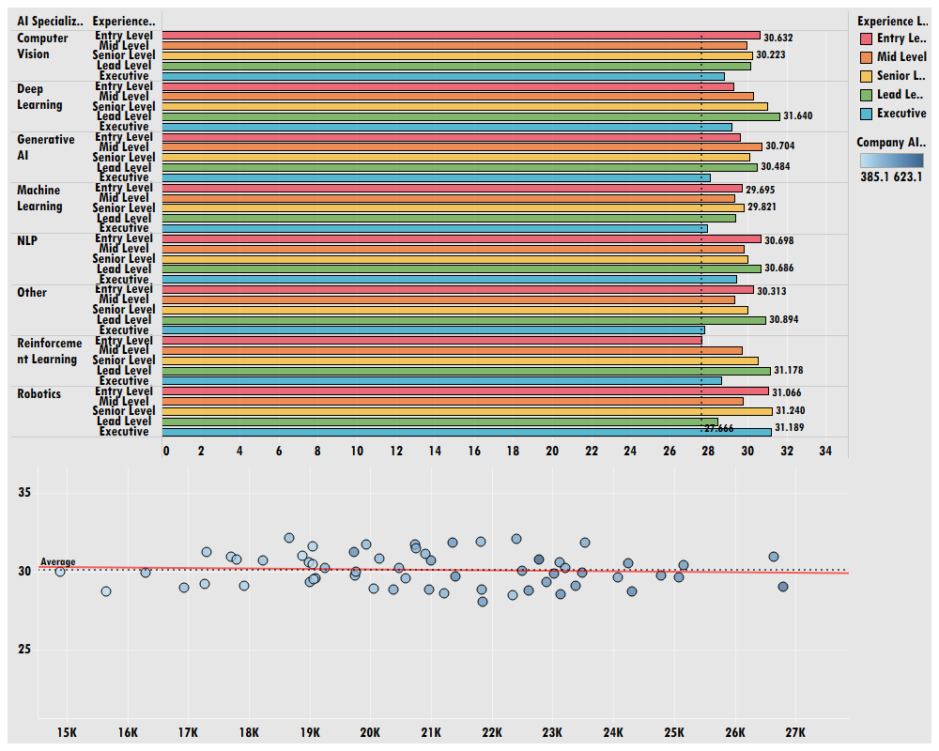

Slide 35
Systemic Parity Ceiling (~30% Baseline): Across both individual AI specializations and corporate investment scales, female representation remains tightly constrained within a 28% to 32% window. Structural workforce imbalances are industry-wide and resistant to passive organizational scaling.
Capital & Maturity Ineffectiveness: Financial backing (scaling up to $27B+ in investment) and advanced technological maturity (scores up to 623.1) fail to improve gender diversity metrics. Neither capital deployment nor technical sophistication inherently resolves representation gaps.
The Leadership "Leaky Pipeline": Gender imbalances worsen along career progression pathways. Female representation consistently drops at the Executive tier across major specializations like Machine Learning (27.94%), Generative AI (28.06%), and Other AI sectors (27.77%), pointing to systemic friction in advancing female talent from lead/senior roles into C-suite positions.
Strategic Diversity Imperative: Because neither capital expansion nor operational AI growth solves the gender gap, leadership must replace passive hiring assumptions with active, structural DEI frameworks—targeting executive leadership pipelines and benchmarking against rare high-performing sectors like Robotics (where female executive representation reaches 31.19%).

Slide 36
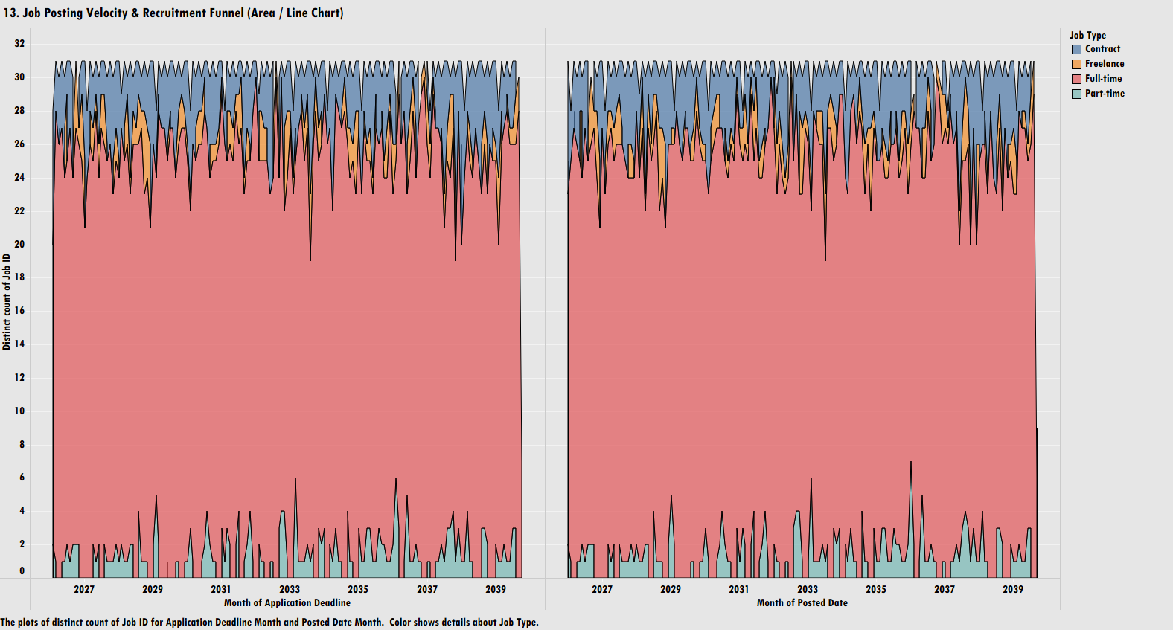

Slide 37
Dominance of Full-Time Employment (Red Area): Full-time roles make up the vast majority of total AI job postings across the entire time horizon, maintaining a baseline volume of 20 to 28 job IDs per month.
Secondary Role Breakdown (Contract, Freelance, Part-Time):
  Contract Roles (Blue Area): Form the second-largest segment, consistently filling top volume band shifts between 28 and 31 job IDs per month.
  Freelance Roles (Orange Area): Form a thin, stable middle band between full-time and contract roles, accounting for 1 to 3 job IDs per month.
  Part-Time Roles (Green Line): Represent a minor fraction along the bottom baseline, fluctuating between 0 and 7 job IDs per month with periodic spikes.
Timeline Matching (Application Deadline vs. Posted Date): The dual-panel view shows near-identical volume patterns across Month of Application Deadline (left) and Month of Posted Date (right), reflecting consistent posting-to-deadline cycle velocity across the multi-year forecast horizon.
Steady Volume Stability: Total monthly job posting counts stay remarkably bounded within a tight band (28 to 31 total postings per month) over the long term, demonstrating steady, non-volatile talent acquisition pipelines.

Slide 38
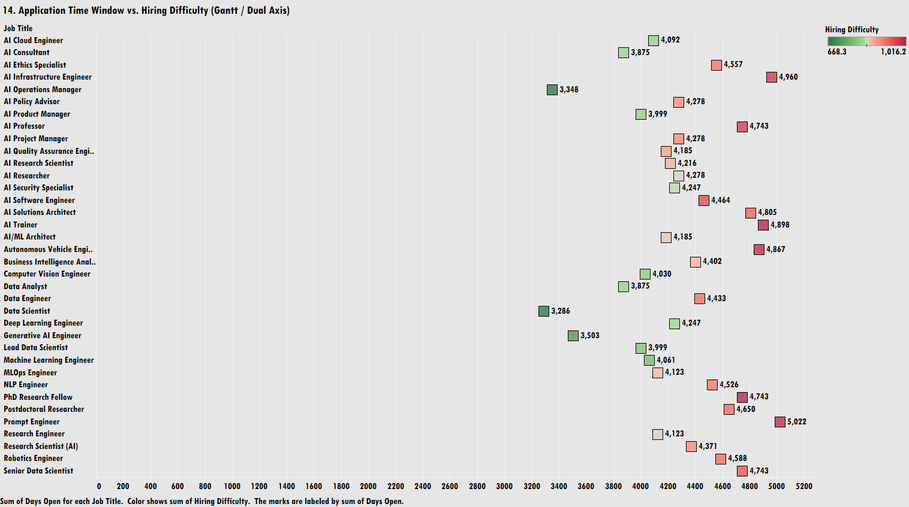

Slide 39
Application Time Window Spectrum (Days Open): Total days open across job titles spans from a minimum of 3,286 days (Data Scientist) up to a peak of 5,022 days (Prompt Engineer).
Direct Correlation Between Duration and Hiring Difficulty:
  High Difficulty / Extended Window (Dark Red Blocks): Roles requiring the longest application time windows carry the highest hiring difficulty scores (~1,016.2). Key positions include Prompt Engineer (5,022 days), AI Infrastructure Engineer (4,960 days), AI Trainer (4,898 days), and Autonomous Vehicle Engineer (4,867 days).
  Low Difficulty / Shorter Window (Dark Green Blocks): Roles with lower hiring difficulty scores (~668.3) are open for significantly shorter total durations, led by Data Scientist (3,286 days), AI Operations Manager (3,348 days), and Generative AI Engineer (3,503 days).
Moderate Time Horizon Clustering: A majority of technical roles—including Data Analyst (3,875 days), AI Product Manager (3,999 days), Machine Learning Engineer (4,061 days), and AI/ML Architect (4,185 days)—cluster in the 3,800 to 4,200 days range with moderate-to-low difficulty scores (light green to light orange).
Research and Specialized Roles Baseline: Advanced research and specialized engineering roles—such as PhD Research Fellow (4,743 days), Postdoctoral Researcher (4,650 days), and Robotics Engineer (4,588 days)—consistently sit at the upper end of the timeline scale with elevated hiring difficulty (dark pink/red).

Slide 40
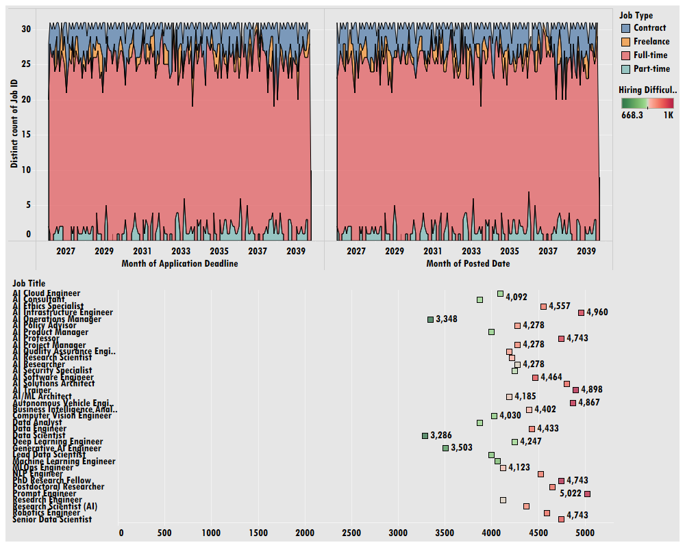

Slide 41
Full-Time Headcount Stability: Core AI talent acquisition relies overwhelmingly on full-time employment contracts, maintaining a steady, non-volatile baseline of 20 to 28 job postings per month over the long term. Flexible contract and freelance options serve as minor operational buffers.
Time-to-Fill Friction in Specialized Roles: Requisition duration directly correlates with recruitment difficulty. Specialized technical roles—such as Prompt Engineer (5,022 days open), AI Infrastructure Engineer (4,960 days open), and Autonomous Vehicle Engineer (4,867 days open)—require significantly longer application windows and carry the highest hiring difficulty scores (~1,016.2).
Low-Friction Talent Pathways: Established foundational roles—including Data Scientist (3,286 days open), AI Operations Manager (3,348 days open), and Generative AI Engineer (3,503 days open)—feature substantially shorter recruitment cycles and lower difficulty scores (~668.3).
Strategic Recruiting Operations: Talent acquisition teams can rely on predictable, evergreen posting velocity for standard full-time roles, but must deploy dedicated headhunting resources, internal upskilling, and contingent contract options to mitigate risk around bottleneck roles with extreme time-to-fill requirements.

